Slide 1
The Emotional Politics of Social Work and Child Protection
Jo Warner
School of Social Policy, Sociology and Social Research, University of Kent
IRO Conference: Not to Stop Questioning…
London, Tuesday 17 October 2017

Slide 2
What do we mean by ‘emotional politics’ in social work
  How politics is emotional
  How emotions are political
What characterises the emotional politics of our work today?
  Focus on social class
How and why did it happen?
How can we challenge it?

Slide 3
The child, nation, culture
Children represent the future: ‘the keepers and the guarantors of humanity’s reputation’ (Marina Warner, 1994, p 35)
In media & political sphere, stories about children:
  Convey profound messages about political and social well-being
  ‘Attract eye-balls’ in the competition for media attention (Moeller, 2002, p37)
  Invoke collective emotional responses to suffering: ‘That child could be mine’ (Ahmed, 2004, p196)

Slide 4
Empathy and emotionalisation
Empathy is vital to political survival:
  “the visceral connection between politician and voter , the strand of communication that makes the latter believe – or half-believe - that the former grasps what life is really like for him [sic]” (d’Ancona, 2011)
Stories about children are central in political and media discourse because of the emotions that attach to them

Slide 5
Anger and shame
Anger underpins all politics (mainstream parties and social movements):
Political support is gained and maintained through mobilising anger on key issues;
Organising anger involves articulation of an identity which distinguishes one party from another
Mobilising anger involves ‘moralising talk’ which deals in binaries and polarised positions on (complex) issues.

Slide 6
From personal empathy…
“Watching the news last night took my breath away. My wife Sam couldn’t watch and left the room […] as a father of three young children I would do anything to protect, I am sickened to the core by these crimes.”
(David Cameron, leader of Conservative Party then in opposition, writing in The London Evening Standard, 12th Nov 2008)

Slide 7
...to the nation as an angry subject
Next day, writing in The Sun:
“Britain’s sickened and we’re angry too – outraged at the failures that left a child to die” (Cameron, 13th Nov 2008)
Feeling rule (how we should feel): to be compassionate in the face of such suffering is to be angry
Framing rule (how we should think): “Heads must roll”

Slide 8
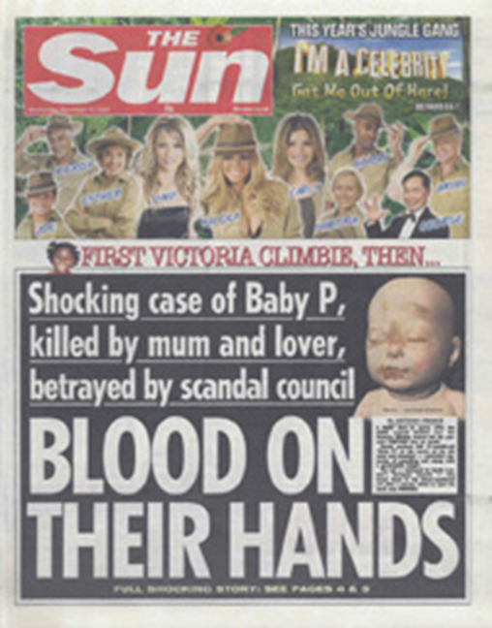
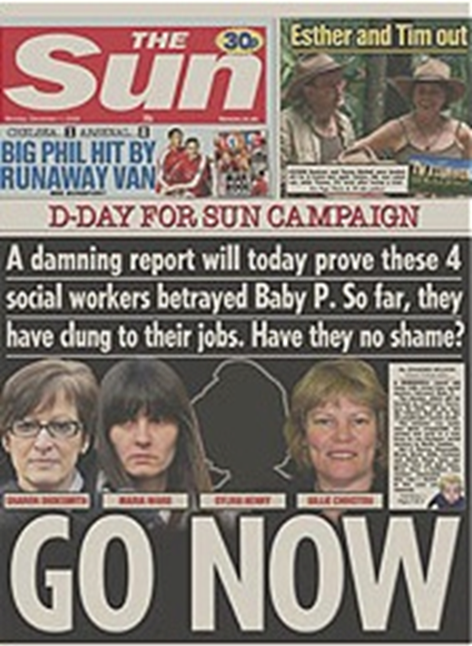
Notes:
12th Nov 2008
1st Dec 2008

Slide 9
Contempt and disgust
Not only at the way the child died - the nature of the abuse and neglect - but also the way the child had lived
Disgust at the living conditions in the family home was a prominent feature of news reports of the Baby P story.
Anxiety is about thresholds but deeper moral anxieties about social structure are also at work

Slide 10
“...how is it that this disgusting piece of humanity, in the shape of the mother, was ever allowed to have the child in the first place? She came from a family of drunks, never worked and watched porn all day. Her council house – she had to have one didn’t she? – stank. Why wasn’t the child taken away from her at birth?”
(MacKensie, The Sun, 13 November 2008)

Slide 11
The unspeakable case of Baby P raises profound questions about the state of Britain today. The welfare state has created some communities with no morality [...] this is not just a story about Haringey, or the child protection system. It is a story about Britain today [...] The story of Baby P provides a glimpse into the colossal failure of community, in which dependency on the State is a way of life (The Times 2008a: 2)

Slide 12
“The tragic probability is that had Baby P survived, he would probably have been unruly by the time he was 13 or 14, at which he wouldn’t have been Baby P any longer, he’d have become ‘feral’, a ‘parasite’, a ‘yob’, helping to infest our streets. All terms used on newspaper websites recently.” (Martin Narey, 2008)

Slide 13
The story of Baby P was characterised by a dramatic form of Othering of so-called ‘underclass’ parenting identities.
It reinforced a binary distinction between ‘good’ (preferably middle-class) and ‘bad’ parents.
Class contempt and disgust, and also the struggle for respectability, are at the centre of these processes
The story also mobilised a narrative about middle-class parenting and social work

Slide 14
“Let us be plain. If one tenth part of the events that took place in Baby Ps mother’s house had happened in a middle-class home, the child would have been snatched away in minutes by haughty social workers...They are always prone to imagine abuse among the respectable, even when it’s not taking place.” (Hitchens, 2008)

Slide 15
“The real scandal, of course, is not just that social workers too often fail to act where a child is being genuinely ill-treated, but that they are far too quick to seize children from responsible parents for wholly inadequate reasons.” (Booker, Sunday Telegraph, 2008)

Slide 16
The story of child protection in recent years is not only about othering the ‘underclass’, but also middle class anxieties about children and parenting:
  Focus on risk, and ‘fear-for-our-children’ (Hacking, 2003)
  ‘Children are the final fundamental of our identity’ (ibid.)
  Economic collapse and ‘fear of falling’ among m/c parents (e.g. grammar schools)
  Growing divergence of parenting experience (reflection of inequality)
  Paranoia about social work

Slide 17
To what extent do these ‘emotional politics’ bear down on practice?
How can they be challenged and changed?

Slide 18
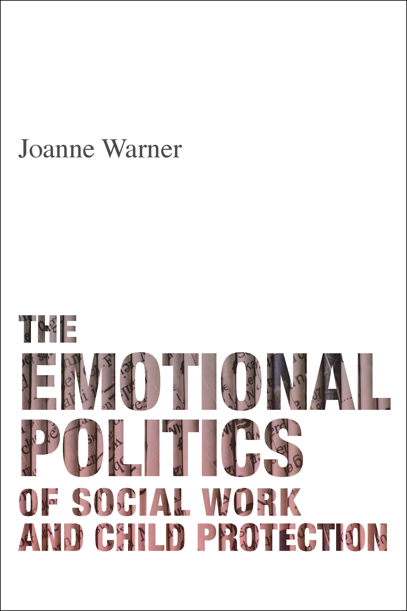
To read more...
http://www.policypress.co.uk/display.asp?K=9781447318439&ds=New+Titles&dtspan=150:150&sort=sort_date/d&m=26&dc=88

