Slide 1
Recalcitrance, compliance and the presentation of self
Exploring the concept of organisational misbehaviour in an English local authority child protection service
by jadwiga leigh

Slide 2
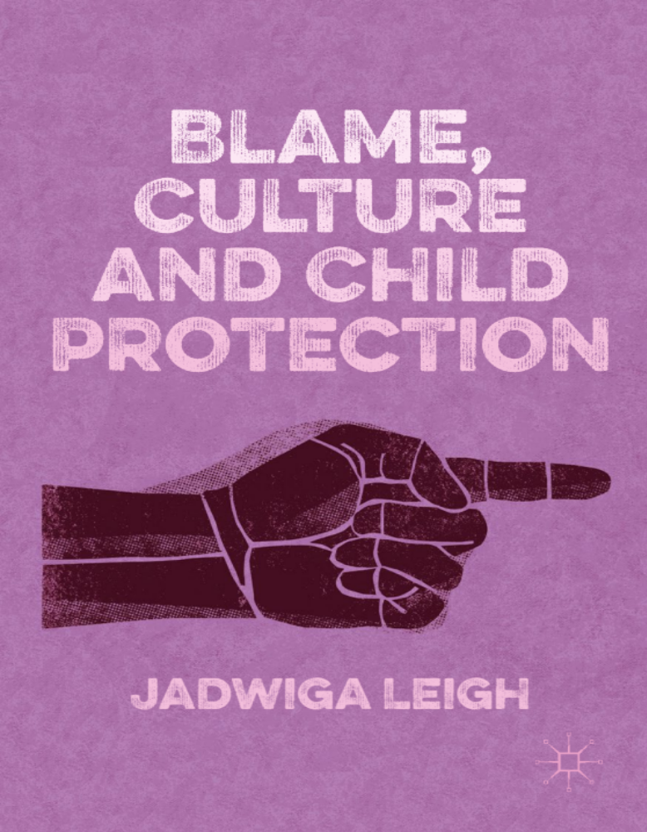
Key findings
Symbolic interactionism (from whose perspective?) and social constructionism (how are we shaped by culture?)
Organisational (mis)behaviour: Why do we do what we do?
Moral lines of discrimination: How do we blur what is seen with what is purposefully overlooked?
Impression management: Performativity and sense of self
Dramaturgical theory: Front stage and back stage
Language: Collquial terms or cultural sayings

Slide 3
“Just nod and smile”
Team managers feared for their jobs
£5million savings
Reduce accommodation of young people; Merge teams
Need to get 'outstanding'
Unannounced OFSTED inspection expected
Moral lines of discrimination
Star chart
Recalcitrance
Provide quality service without the required funding
Managers responsible for team performances
Compliance
Disguised resistance
Do it for the child and not for OFSTED (Schooling, 2017

Slide 4
Cloak of competence v cloak of conformity?
Cloak of competence has been an enduring theme in studies of professional or occupational socialization….focusing on how professionals acquire the skills, values and attitudes expected of them from their profession
Cloak of conformity is seen to jeopardise innovation and creative potential… as social workers are encouraged to do as they are told with minimum fuss.

Slide 5
Changing landscapes
An email arrived today telling staff that no more children are to come into care because the [local authority] has gone £5 million over budget. It said “if we do not reduce spending we will have to look elsewhere to recoup our losses”. This comment seems to have created panic as the rumours suggest that redundancies are on the horizon.
(Field notes, Day 5)

Slide 6
Negotiating new territories
Me: A star chart?
Beth: Yes, a star chart was put up last week by Debbie so we can see who is meeting targets on time. Those of us who complete an assessment on time, get a gold star. Those who don't get a red one. If you get one red star then you have a meeting with the manager, two red stars then you're sent to [service unit manager] and could face disciplinary procedures.
Me: What?
Beth: Yes, it's bullshit, it's patronising and demoralising. We don't sit on these assessments for fun. I'm way over my recommended allocation already.
(Beth, 8 years qualified)

Slide 7
Just nod and smile: an individual approach
Kenny:…at first Tina came here as an agency worker and then I find out she has been made permanent and promoted to senior practitioner without being interviewed which a lot of us are not happy about. When Beth was complaining about it she said “I can't believe they've done that. It was never advertised. She has just literally been offered a senior prac post on a plate”. Well I started laughing. I said “You know why they gave her that, don't you? It's “cos she just nods and smiles”.
(Kenny, 10 years qualified)

Slide 8
Just nod and smile: a team approach
Jane: Our summons is like what we get at the end of each month if our team under performs. We get a list from [name of senior manager] summoning those who haven't completed their CP (child protection) visits within timescale to the office.
Me: No way, that's like you're at school.
Jane: It's worse than that. If you get called in more than once you're out so we've started covering for each other so no one gets called. I download all the CP visits that are outstanding one week before the month's end and then one of us does them all in one day and we cover for that person whilst they're out.
Me: Have you thought of talking to someone about this?
Jane: We've talked to the union about what's been going on but they are no use, they don't understand what it means. It's just easier to nod and smile.
(Jane, 5 years qualified)

Slide 9
MAIN POINTS:
WHAT DO YOU TAKE FROM THESE FINDINGS?
(IN)VISIBILITY OF ORGANISATIONAL CULTURE
FRONT STAGE PERFORMANCES V BACK STAGE PERFORMANCES
WHEN THE TWO REGIONS BLUR INTO ONE
MORAL LINES OF DISCRIMINATION: HOW DID THESE ACTORS BLUR WHAT WAS SEEN WITH WHAT WAS PURPOSEFULLY OVERLOOKED?
COERCIVE POWER V COACTIVE POWER
CHILDREN AND THEIR FAMILIES: HOW DID THIS BEHAVIOUR AFFECT THE SERVICE THEY WERE RECEIVING?

Slide 10
IMPORTANCE OF LANGUAGE USE AND INSINUATION
Sometimes, during cycles of intermittent closure, a professional worker would decide to adopt a more controlling stance. However, this was defused by apparent co-operation from the family. We have called this disguised compliance because its effect was to neutralize the professional’s authority and return the relationship to closure and the previous status quo (Reder et al, 1993, pp 106-7).

Slide 11
DISGUISED COMPLIANCE
The examples they give of how this action played out in practice were as follows: a sudden increase in school attendance; attending a run of appointments; engaging with professionals such as health workers for a limited period of time; or cleaning the house before a visit from a professional.

Slide 12
SERIOUS CASE REVIEW FOR POPPY WIDDISON
This case and others provide instructive case scenarios against which multi-agency professionals are assisted to develop tools and skill in the practice of ‘respectful uncertainty’ as a means to combatting disguised compliance, particularly in safeguarding children where parental substance misuse and or domestic abuse are key causes for concern (2016: 16)

Slide 13
SLOPPY LANGUAGE LEADS TO SLOPPY THINKING
If enough people in any society are incompetent in their thinking and in consequence take bad decisions, their bad decisions affect the whole of that society. The very well-being of society depends in part on good grammar (Gwynne, 2012:7)

