Slide 1
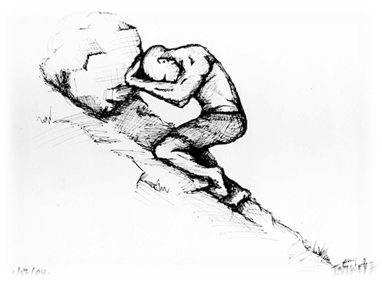
Childhood Adversity & Resilience
Andi Brierley Leeds YJS

Slide 2
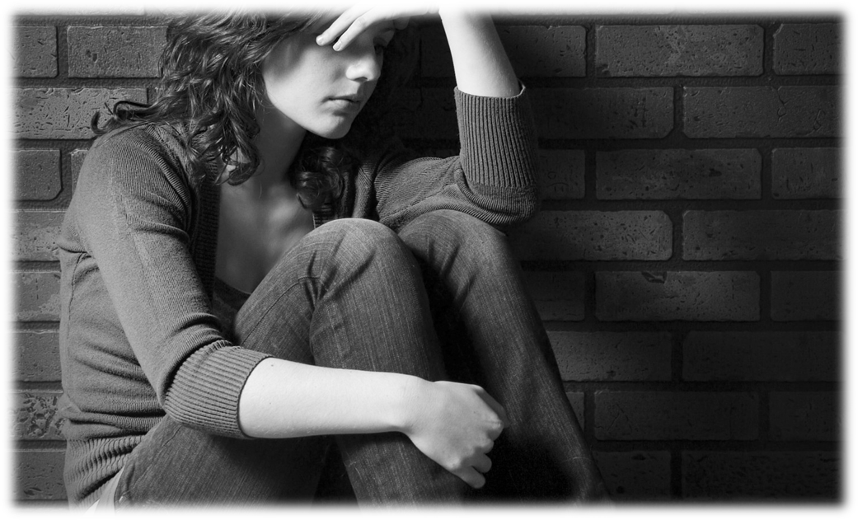
Biological transfer of stress
“The children of mothers who reported multiple stressful events during pregnancy are more likely to develop behavioural problems throughout childhood.”
Monique Robinson (2017)
Early Career Fellow, Telethon Kids Institute, University of Western Australia
Notes:
Biological - "The stress hormone cortisol may be a key factor in programming the fetus, baby or child to be at risk of disease in later life. Cortisol causes reduced growth and modifies the timing of tissue development as well as having long lasting effects on gene expression," she will say. Prof Holmes British Neuroscience Association (2013)

Slide 3
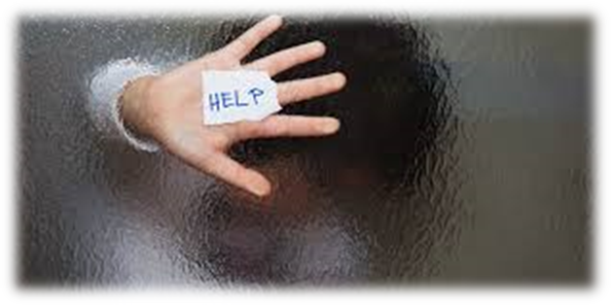
Environmental Transfer of Stress
Age Home
1 Middleton Leeds
2 London
2 Scotland
4 Hostel in Leeds
4 Warfedale Grove
6 Wrangthorne Terrace
7 Foster Care
7 Foster Care
8 Foster Care
Age Home
9 Roundhay Gardens
10 Westminster Crescent
10 Markham Avenue
10 Westminster Crescent
11 Lampton Place
11 Ashton Place
11 Thorpe Road
12 Coalville (Stoke)
13 Abbey Hulton (Stoke)
Notes:
Environmental – By 13 years old, I had lived in 18 different places which meant almost no schooling. I had to rebuild relationships in every disadvantaged area we lived. I always had houses that were deteriorating which meant the relationships tended to be with other children in similar circumstances.
Identity – I never ad time to build a character based on my relationships, coupled with the lack of education and consistent contact with adults, I never really found an identity which impacted on my relationships and decisions.

Slide 4
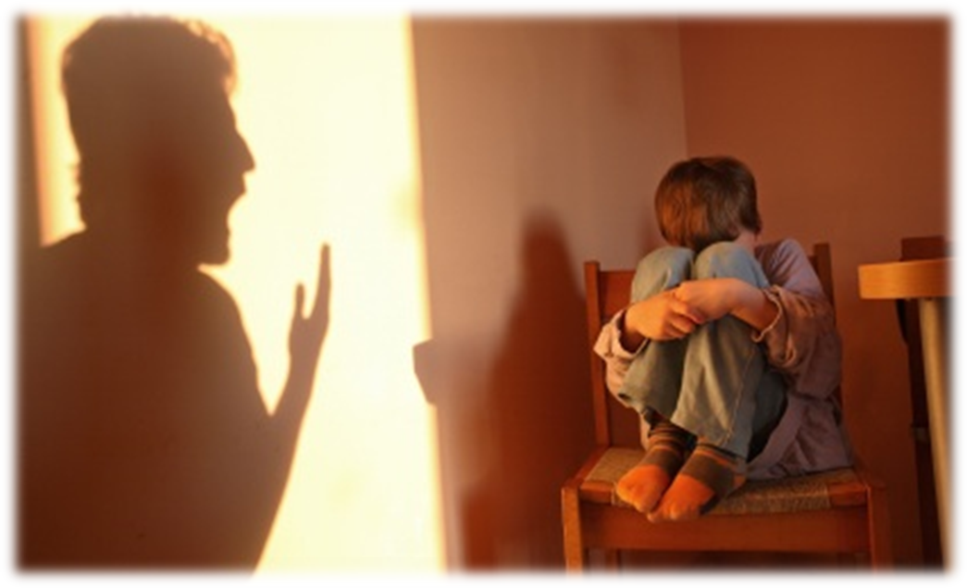
School didn’t help me like drugs!
11 - year 7 smoking cigarettes
12 – Year 8 smoking cannabis
15 – Year 10 smoking heroin
Notes:
I knew I was not good at much and drugs after made me feel better about myself. I spent time lots of adults that took drugs so I wanted to be, behave and act like them. Once you get hooked on drugs at a young age, it really does get a hold of you as you don’t have the knowledge of strength to fight it and it controls your whole functioning.

Slide 5
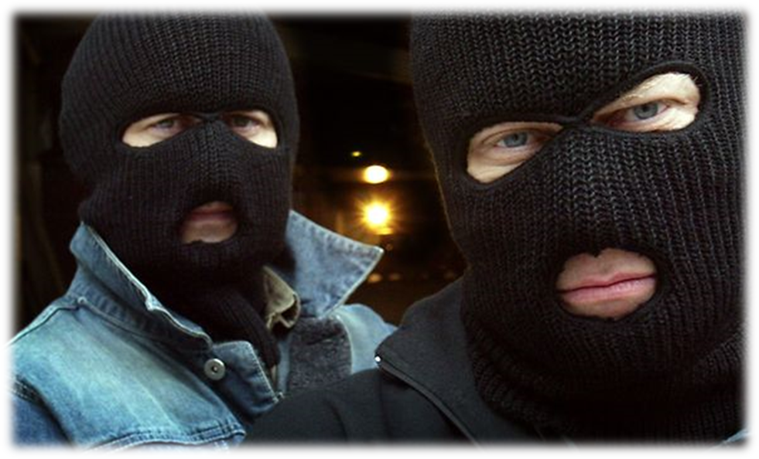
In a world that is trying to change me, someone will accept me for me.
Notes:
Crime – With the lack of education, drugs and poor decision making, I then started to realise that most of the adults in my life, particularly males were involved in offending. Similar to drugs, you know it is wrong but it becomes acceptable for you and those in your household.
This then leaves you vulnerable to exploitation for 2 main actors.
1 – Due to the identity you have created and them exploiters recognising this and 2 – Because you are already suspicious of authority figures which means you wont seek support.
This is why I believe the strategy to tackle this can not be solely on the police of LA. WE have to expect moor from community organisations as they have the trust of the community and also due to them being able to maintain relationships long after any intervention is complete.

Slide 6
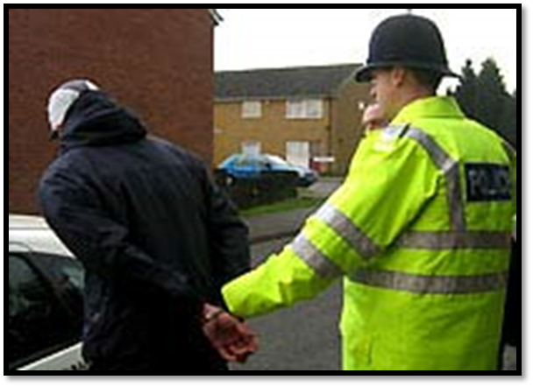
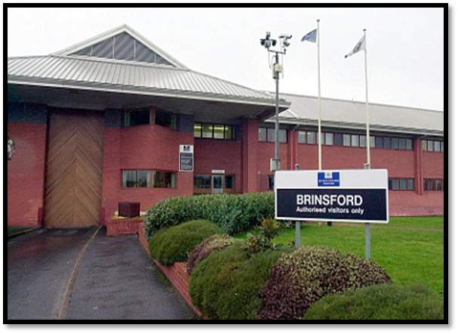
The right intervention for an exploited traumatised, heroin addicted YP?
Notes:
When I wrote my book, I started to ask questions of the adults around me and not just authority. It is extremely difficult to know everything as an authority so we must find a way of the information from communities being streamlined into the authority. Because these are our children, we must see Criminal Exploitation in the same way we so Sexual and shame the perpetrators. In my view, they are viewed as glamerous criminals that can not be challenged, however this needs to change so we can challenge this within the community.

Slide 7
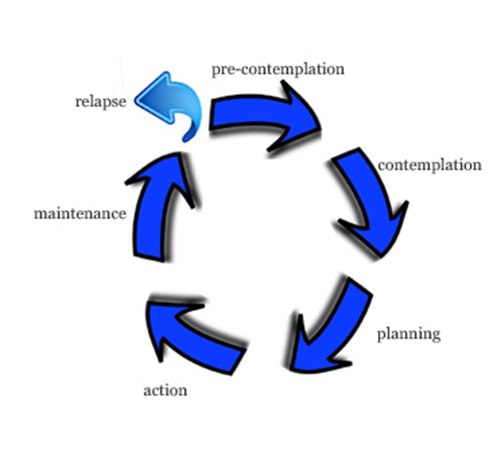
4 years (Re-habilitation)
Notes:
Re-in Rehabilitation and in Re-integration implies that prisoners need to be restored into a previous state in their lives. If 25% of adults prisoners were in care and 42% were excluded from school, this indicates that they were never in a position to have a crime free life. My view on this is that to ensure the public know this, we need to rephrase the words we use for specific offenders. This will make the public aware that we need to build some inmates, not rebuild them which may increase complassion which will help with employment opportunities.

Slide 8
Kelly Price – Love Sets You Free ♫
Here I am, all alone, can’t let them get the best of me.
And these walls, closing in, closing in slowly.
But aint no way they can hold me down, I wont allow it.
Now I believe, now I believe that love sets you free.
♫
Notes:
These lyrics meant that I have always felt like I was being held back. This may or may not have been entirely true, however any intervention with me needed to take my perception into account.

Slide 9
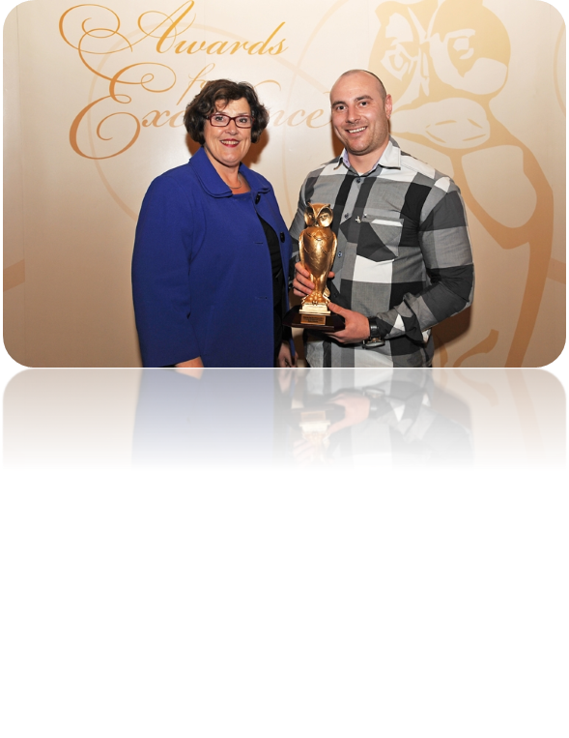
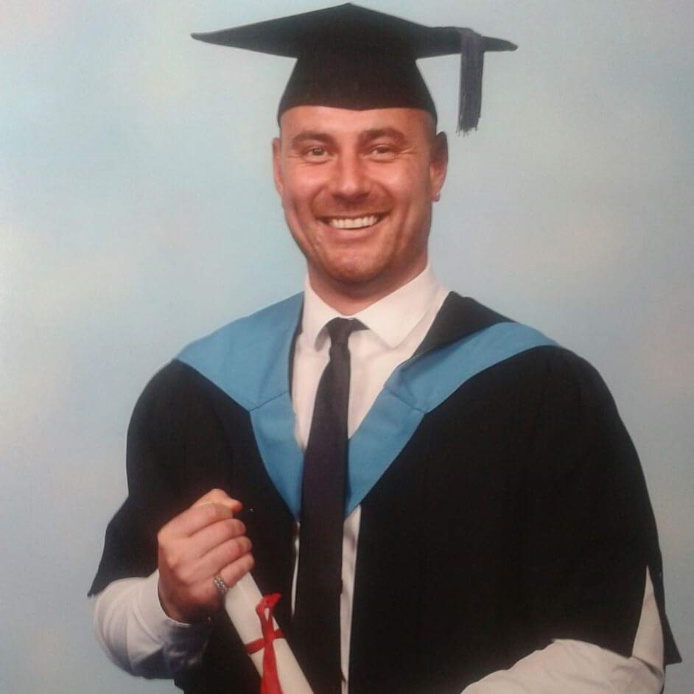
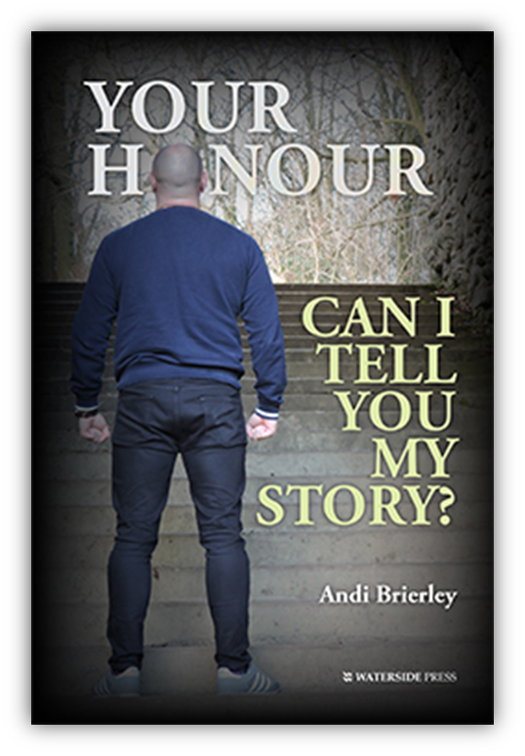
Love & Resilience Sets You Free
2011
2013
2019
Notes:
2011 – LCC Award for programmes created
2013 – Qualified in Youth Justice & NVQ Level 4 in WWP
2019 – Published author about my experiences

Slide 10
Culture of Restorative Practice
Leaders that create a culture of:
High Support High Challenge
= Empowered Children & Families

Slide 11
Leeds YJS CLA Journey
Clear Approach (CLA) 2013
Laming – In Care Out Of Trouble 2016
YJS Created CLA/CL Specialist Role

Slide 12
Four Key Areas
Training and Raising Awareness
Data and Profiling
Voice and Influence
Improving CLA Experience (Youth Panels)

Slide 13
Training and Awareness
CSWS/YJS/WY Police and Care Leavers
Laming’s finding around the disproportionate over representation within the CJS.
Developing knowledge around Complex Trauma, Toxic Stress and Adverse Childhood Experiences (ACE’s).
Encouraging services to implement restorative responses to Children Looked After as an appropriate alternative.

Slide 14
Data and Profiling
65% CLA known to Leeds YOS had been in residential homes.
65% CLA known to Leeds YOS had been in more than 3 placements.
55% CLA known to Leeds YOS had been placed out of Local Authority.
75% CLA known to Leeds YOS had identified learning needs.
(ROCLA - Multi-Agency)

Slide 15
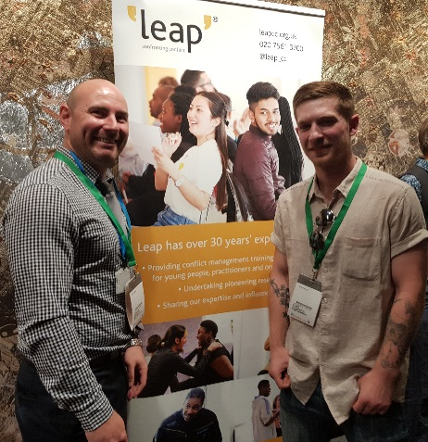
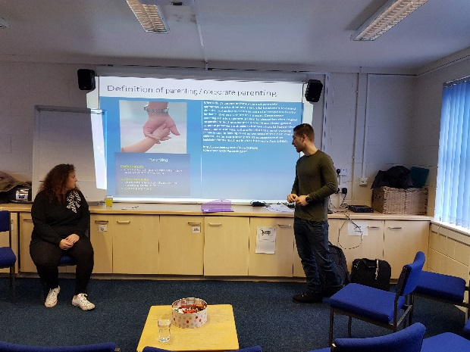
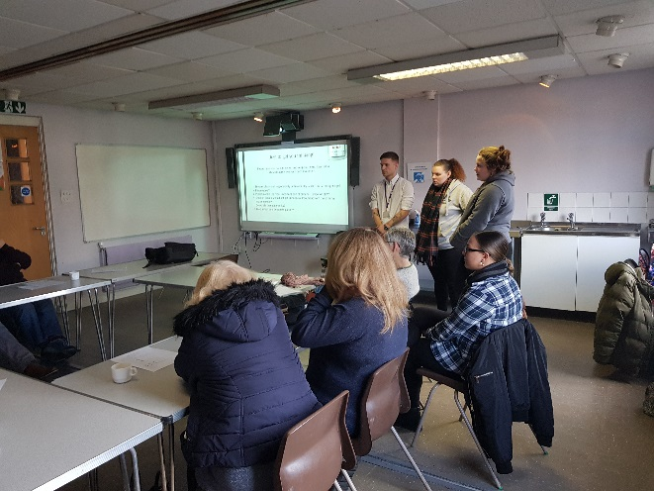
Empowering Peer Support
Culture of High support, High Challenge = Listening to Young People

Slide 16
Your Honour Can I Tell You My Story?
My book takes a journey through Toxic Stress, Adverse Childhood Experiences (ACE’s) & Type 2 Trauma and explains how resilience helped me become a Youth Justice Specialist for Children Looked After can be found on the following websites and others:
Amazon, Waterside Press, WH Smith & Ebay.

Slide 17

Questions?

